Slide 1


Slide 2

B V V Sangha’s
BASAVESHWAR ENGINEERING COLLEGE
Bagalkote ,587102
Department of ARTIFICIAL INTELLIGENCE AND MACHINE LEARNING
Project Demo on :-
ML Based Player Role Classification in Cricket.
Team Members :-
Keerti Nandi (2BA22AI013)
Ibrahim Indikar (2BA22AI010)
Prashant R H (2BA22AI025)
Vivek S Hosur (2BA22AI052)
Project Guide Project Coordinator Head of Department
(Dr. Bharati Reshmi ) (Prof. Lakshmi Kolur) (Dr. Anil Devangavi)

Slide 3
Contents
Introduction
Objectives
Literature Surveys
Problem Definition
Dataset Description
System Requirement Specifications
System Architecture and Proposed Methodology
Conclusion
Reference

Slide 4
Cricket is a dynamic sport where players contribute in distinct roles such as Batsman , Bowlers , All-rounders. Accurate classification of these roles is vital
for team selection, strategy development, and performance analysis.
With advancements in data analytics, machine learning (ML) offers a powerful approach to automate this classification process. By analyzing player statistics like batting averages, bowling economies, ML models can identify patterns and assign roles effectively.
Project focuses on developing a player role classification system using ML, aiming to assist in team optimization and data-driven decision-making in cricket.
Project also helps to make a balanced and perfect teams for the tournaments.
Introduction

Slide 5
Automate Role Identification: Develop a machine learning model to automatically detect and classify player roles based on performance metrics, game statistics,and positional data.
Improve Team Strategy: Provide accurate insights into player roles to help coaches and analysts optimize team composition and strategies.
Enhance Talent Scouting: Identify and categorize players skills and strengths for better recruitment and role assignment during talent scouting.
Facilitate Performance Analysis: Enable in-depth analysis of players contributions to the game, allowing for role-based performance reviews and improvements.
Objectives

Slide 6
Literature Surveys
Sl No . | Title | Authors | Publication Year | Description
1. | Cricket Player Role Prediction Using Random Forest | A. Kumar , S. Sharma | 2021 | Used Random Forest to predict cricket player roles (batsman, bowler, all-rounder) based on stats like batting average and bowling economy. Achieved 90% accuracy, highlighting the model's strength in handling high-dimensional data and feature importance ranking.

Slide 7
Sl No . | Title | Authors | Publication Year | Description
2. | Application of Random Forest for Sports Performance Prediction | T. Singh, R. Patel | 2019 | Applied Random Forest to predict football player performance, successfully identifying key features like passing accuracy and tackles. Demonstrated effectiveness in handling missing data and reducing overfitting.
3. | Predicting Player Roles in Team Sports Using Random Forest | M. Thomas, J. Collins | 2020 | Used Random Forest to predict basketball player roles, leveraging player statistics such as points scored and assists. The model's ability to handle categorical and numerical data led to strong performance and interpretability.

Slide 8
In cricket, accurately categorizing players into roles such as batsman, bowlers, all-rounders is critical for team strategy and performance optimization. Existing manual or semi-automated approaches are subjective, time-intensive, and struggle with dynamic player performance.
Key Challenges:
Performance Variability: Player contributions differ across match formats and conditions.
Data Imbalance: Underrepresented roles like wicketkeepers lead to biased classifications.
Hybrid Roles: Overlapping skill sets (e.g., batting all-rounders) complicate the process.
Problem Definition

Slide 9
The cricket player dataset contains 17,389 records(rows) and 17 columns, capturing detailed information about players.
Key features include personal details like name, date of birth, gender, as well as performance metrics such as runs scored, batting average, strike rate, best score, wickets taken, bowling average, strike rate, and best bowling figures.
The dataset is a mix of categorical and numerical data , Numerical fields like runs and wickets offer quantifiable metrics for player performances , while categorical fields such as gender and batting style classify players into distinct groups.
Dataset Description

Slide 10
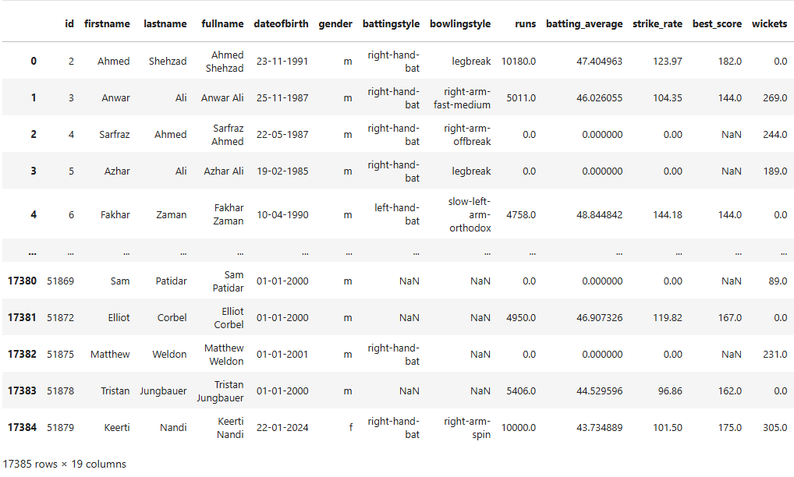

Slide 11
System Requirement Specifications
Hardware :-
Processor :- Intel i5 or above
RAM :- 8GB or higher
Disk Space :- Minimum 20GB
Software :-
Python (libraries : scikit-learn , pandas , matplotlib, etc)
Jupyter Notebook
OS :- Windows , MacOS, or Linux
Web Framework :- Flask ( for creating web interface )
Frontend Technologies :- HTML , CSS ( for designing the user interface )

Slide 12
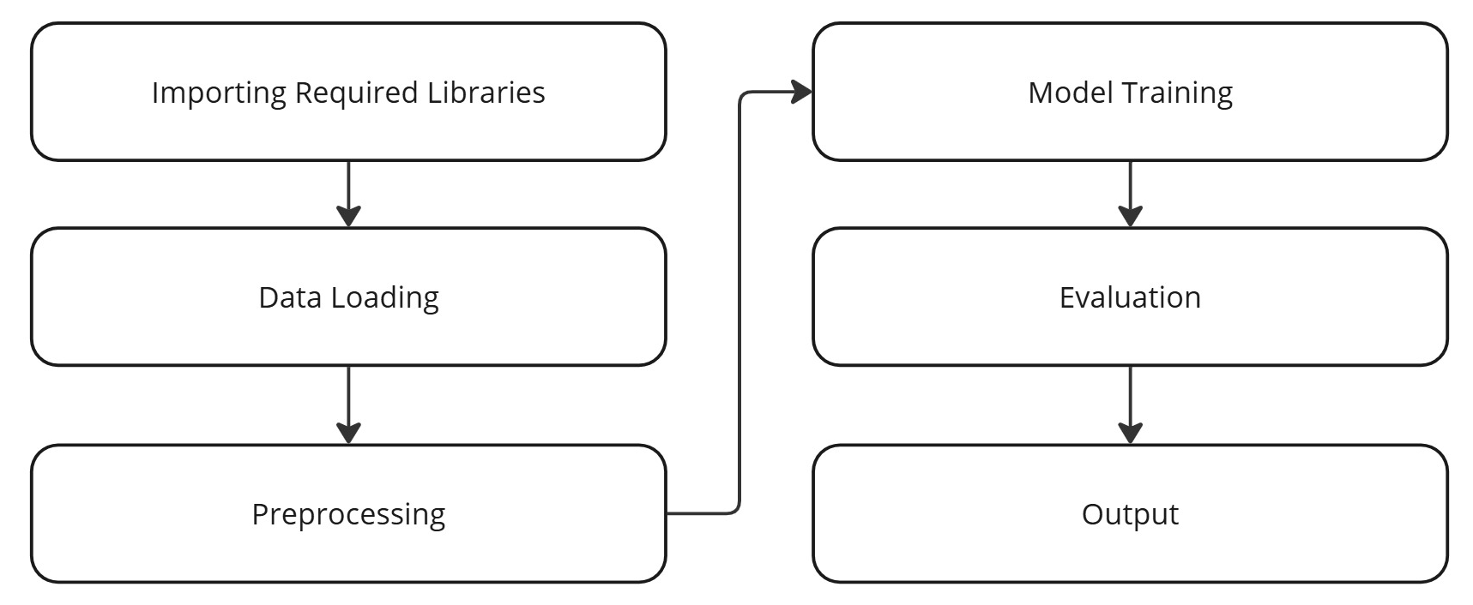
System Architecture

Slide 13
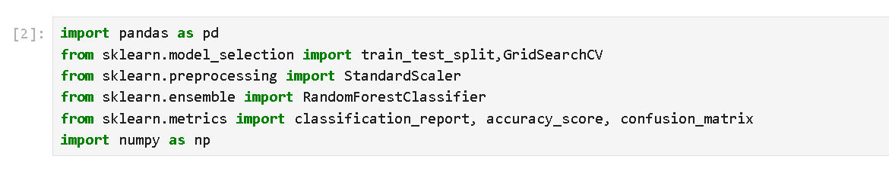
Code Snippet
Import Required Libraries :-
These libraries are critical for:
Loading and manipulating data efficiently (`pandas` and `numpy`).
Splitting the dataset into training and testing subsets (`train_test_split`).
Scaling feature values for optimal model performance (`StandardScaler`).
Building and tuning the model (`RandomForestClassifier` and `GridSearchCV`).
Evaluating model accuracy and classification performance (`accuracy_score`, `classification_report`, `confusion_matrix`).

Slide 14
Data Loading:-
The cricket player dataset contains 17,385 records(rows) and 19 columns, capturing detailed information about players.
Key features include personal details like name, date of birth, gender, as well as performance metrics such as runs scored, batting average, strike rate, best score, wickets taken, bowling average, strike rate, and best bowling figures.
The dataset is a mix of categorical and numerical data , Numerical fields like runs and wickets offer quantifiable metrics for player performances , while categorical fields such as gender and batting style classify players into distinct groups.

Slide 15
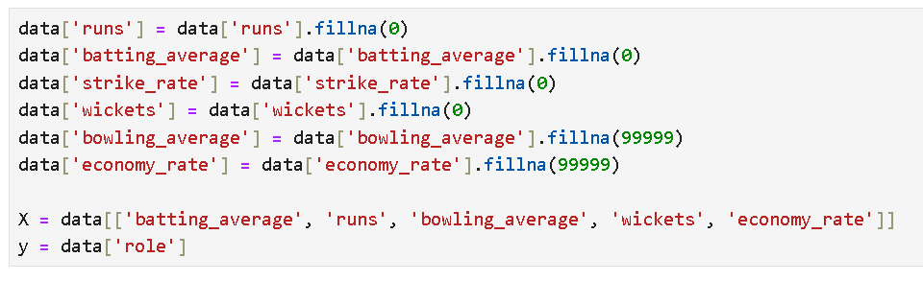
Data Preprocessing:-
Missing values in `runs`, `batting_average`, `strike_rate`, and `wickets` are replaced with `0` to signify no performance data.
‘bowling_average’ and ‘economy_rate` are filled with a large value (`99999`) to indicate poor or undefined performance.
X represents the feature matrix containing performance metric : “batting_average” , “runs”, “bowling_average”, “wickets” , “ economy_rate” . These features capture batting and bowling statistics relevant to player role classification.
The variable y is the target column representing player roles ( ex :- batsman, bowler ,allrounder ).
Together, X and y form the input and output for training the classification model.

Slide 16
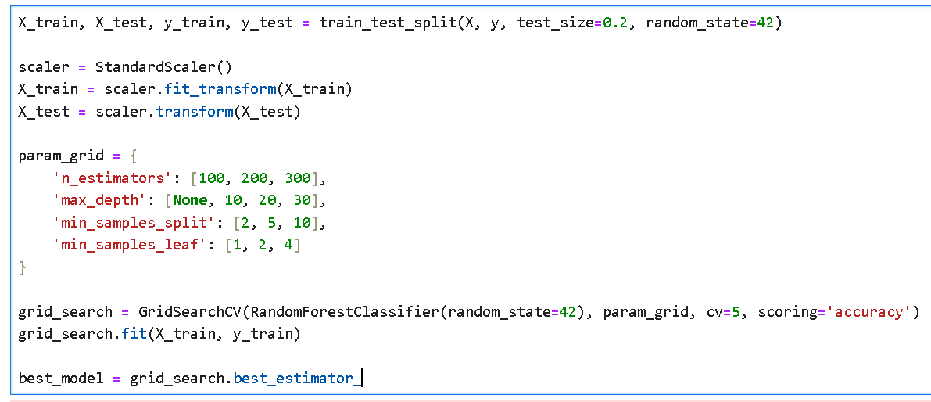
Model Training:-
The dataset is split into training (80%) and testing (20%) subsets using `train_test_split` for model evaluation.
‘random_state=42’ ensures reproducibility of the data split.
`StandardScaler` standardizes features by removing the mean and scaling to unit variance.
`fit_transform` is applied to `X_train`, and `transform` is used on `X_test` to ensure consistent scaling.
`param_grid` defines a range of values for key Random Forest parameters (`n_estimators`, `max_depth`, `min_samples_split`, and `min_samples_leaf`).
This grid will be used to optimize model performance through exhaustive search.

Slide 17
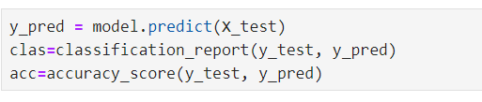
Model Evalution:-
.predict :- The predict() method is used to classify the test dataset (`X_test`) based on patterns learned during training. The output, y_pred contains the predicted roles for each player in the test set.
classification_report :- This generates a detailed evaluation report, including metrics like precision, recall, F1-score, and support for each class (e.g., batsman, bowler, all-rounder). These metrics help assess how well the model differentiates between roles.
accuracy_score :- This computes the overall accuracy, which is the proportion of correctly classified instances out of the total test samples. It provides a high-level measure of the model’s performance.

Slide 18
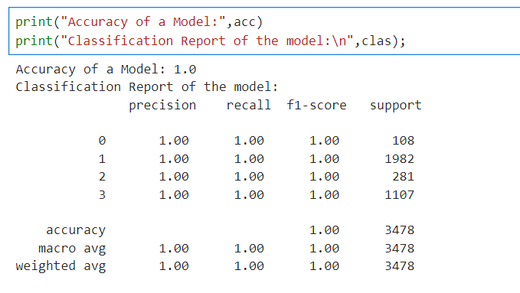
The model exhibits perfect accuracy and balanced performance across all classes. This suggests excellent performance on the dataset.
The "macro avg" represents the unweighted mean across all classes, while "weighted avg" takes into account the support of each class. These averages also reflect perfect scores, emphasizing that the model performed uniformly well across all classes.

Slide 19
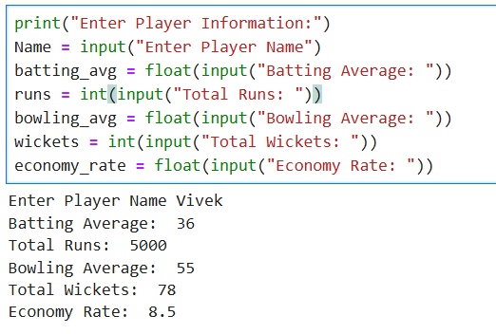
Output:-
This code snippet collects player information such as name, batting average, runs, bowling average, wickets, and economy rate as input from the user.
The values are then processed to predict the player’s role (Batsman, Bowler, or All-Rounder) using a pre-trained machine learning model.
The final output displays the predicted role for the player.

Slide 20
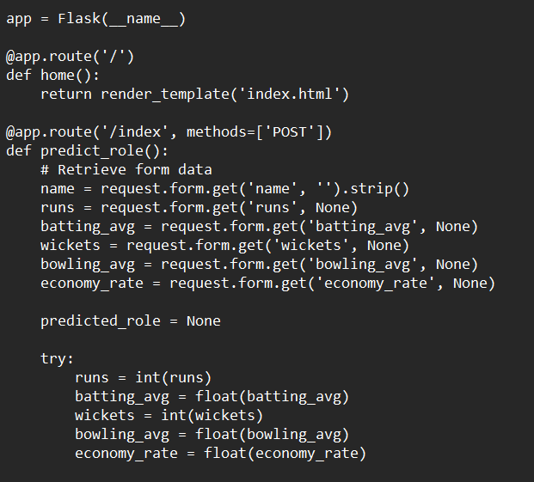
Flask Framework
Flask is a lightweight, flexible web framework for Python that allows developers to build web applications quickly and easily.
Home route(/) : Renders the index.html template when the root URL is accessed
Prediction Route(/index): Handels POST request at /index, processing form data for predictions

Slide 21
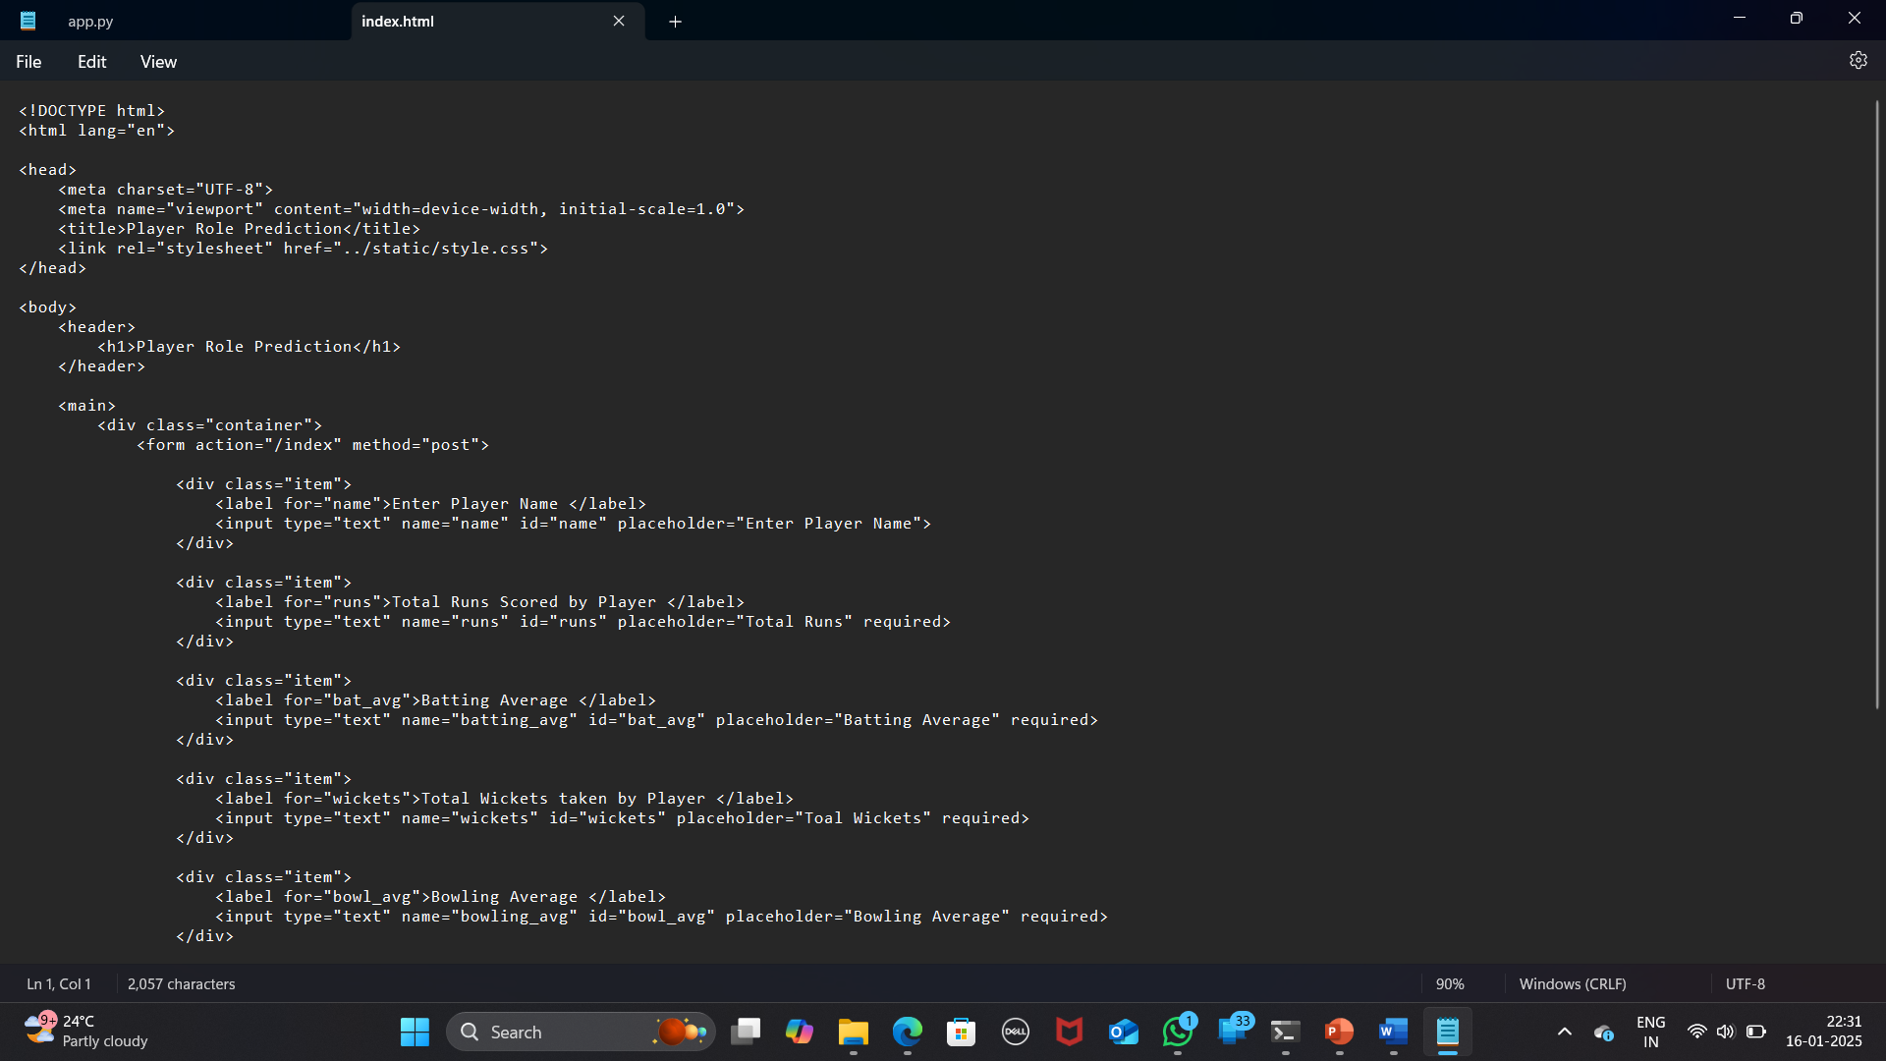
Frontend (html)
<header> :- The ‘header’ section contains the main title “Player Role Prediction”, which serves as the page header
< main> :- The ‘main’ tag encloses the primary content of the page .
<form> :- the ‘form’ element is used to gather input from the user

Slide 22
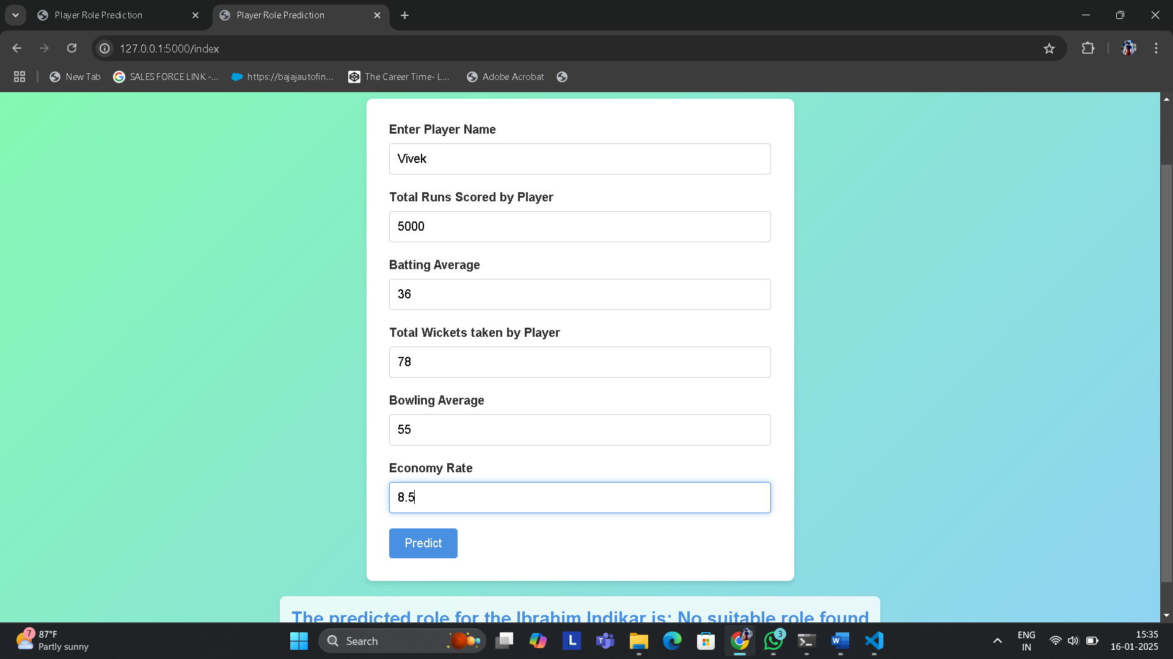
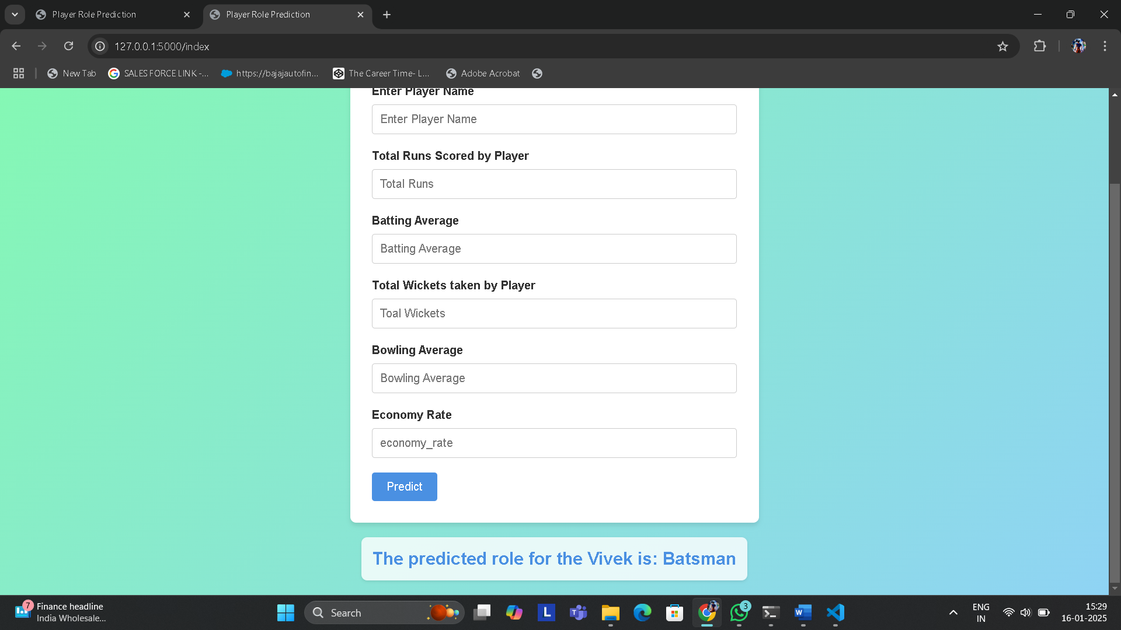
Web Interface
The input form captures a player's details, including name, total runs, batting average, total wickets, bowling average, and economy rate.
Based on these inputs, a machine learning model predicts the player’s role. In the displayed result, the model identifies "Vivek" as a Batsman.
This interface demonstrates how player data can be used to automate role classification, aiding in team selection and performance analysis.

Slide 23
Discussion
Additionally, the feature importance analysis offers valuable insights into which performance metrics, such as batting average and strike rate, contribute most to role classification, enhancing the model's interpretability.
It also enhances talent scouting by identifying players suited for specific roles and aids coaches and analysts in tracking performance trends. Looking ahead, implementing cross-validation could improve the model's generalizability across different datasets, while integrating live match data would ensure the model reflects players' evolving performance.

Slide 24
Conclusion
In this project, we used a Random Forest Classifier to predict and classify cricket players into distinct roles (batsman, bowler, all-rounder) based on performance metrics such as batting average, bowling economy rate, and strike rate.
The Random Forest model demonstrated high accuracy and robustness in handling diverse and large datasets, effectively identifying the most important features contributing to player classification.
This approach can significantly enhance team strategy and player performance analysis by providing deeper insights into player roles.
Provides a deeper understanding of players strengths and weaknesses, aiding in performance optimization.

Slide 25
References
A Survey of Machine Learning Algorithms in Sports Analytics
Authors :- John D. Smith
Year :- 2021
This paper explores how machine learning techniques are applied to various sports for player classification, performance analysis, and more. (https://www.sciencedirect.com/science/article/pii/S2405452620300299 ).
Machine Learning Algorithms for Classification in Sports
Authors :- Emily R. Johnson
Year :- 2022
A review of different machine learning algorithms used in sports analytics, which might be relevant for your project. ( https://link.springer.com/chapter/10.1007/978-3-030-32038-1_18 ).

Slide 26


